Slide 1
Class Relationships
Notes:
2 seconds

Slide 2
Class Relationships Before
Classes
ConnectFourGUI
ConnectFourBoard
Player
Main
Issues
Poor Encapsulation
Classes were too interconnected - had difficulty working on one class at a time
Poor Code Readability
Did not make use of design patterns
Notes:
15 seconds

Slide 3
Class Relationships Now
Screen
Composite Object containing models
ConnectFourBoard
Disk
Button
TextBox
ConnectFourGUI
View Class in charge of what the user sees
Instantiates one Screen object
Main
Controller class in charge of user interaction
Notes:
20 seconds

Slide 4
Class Diagrams
Notes:
2 seconds

Slide 5
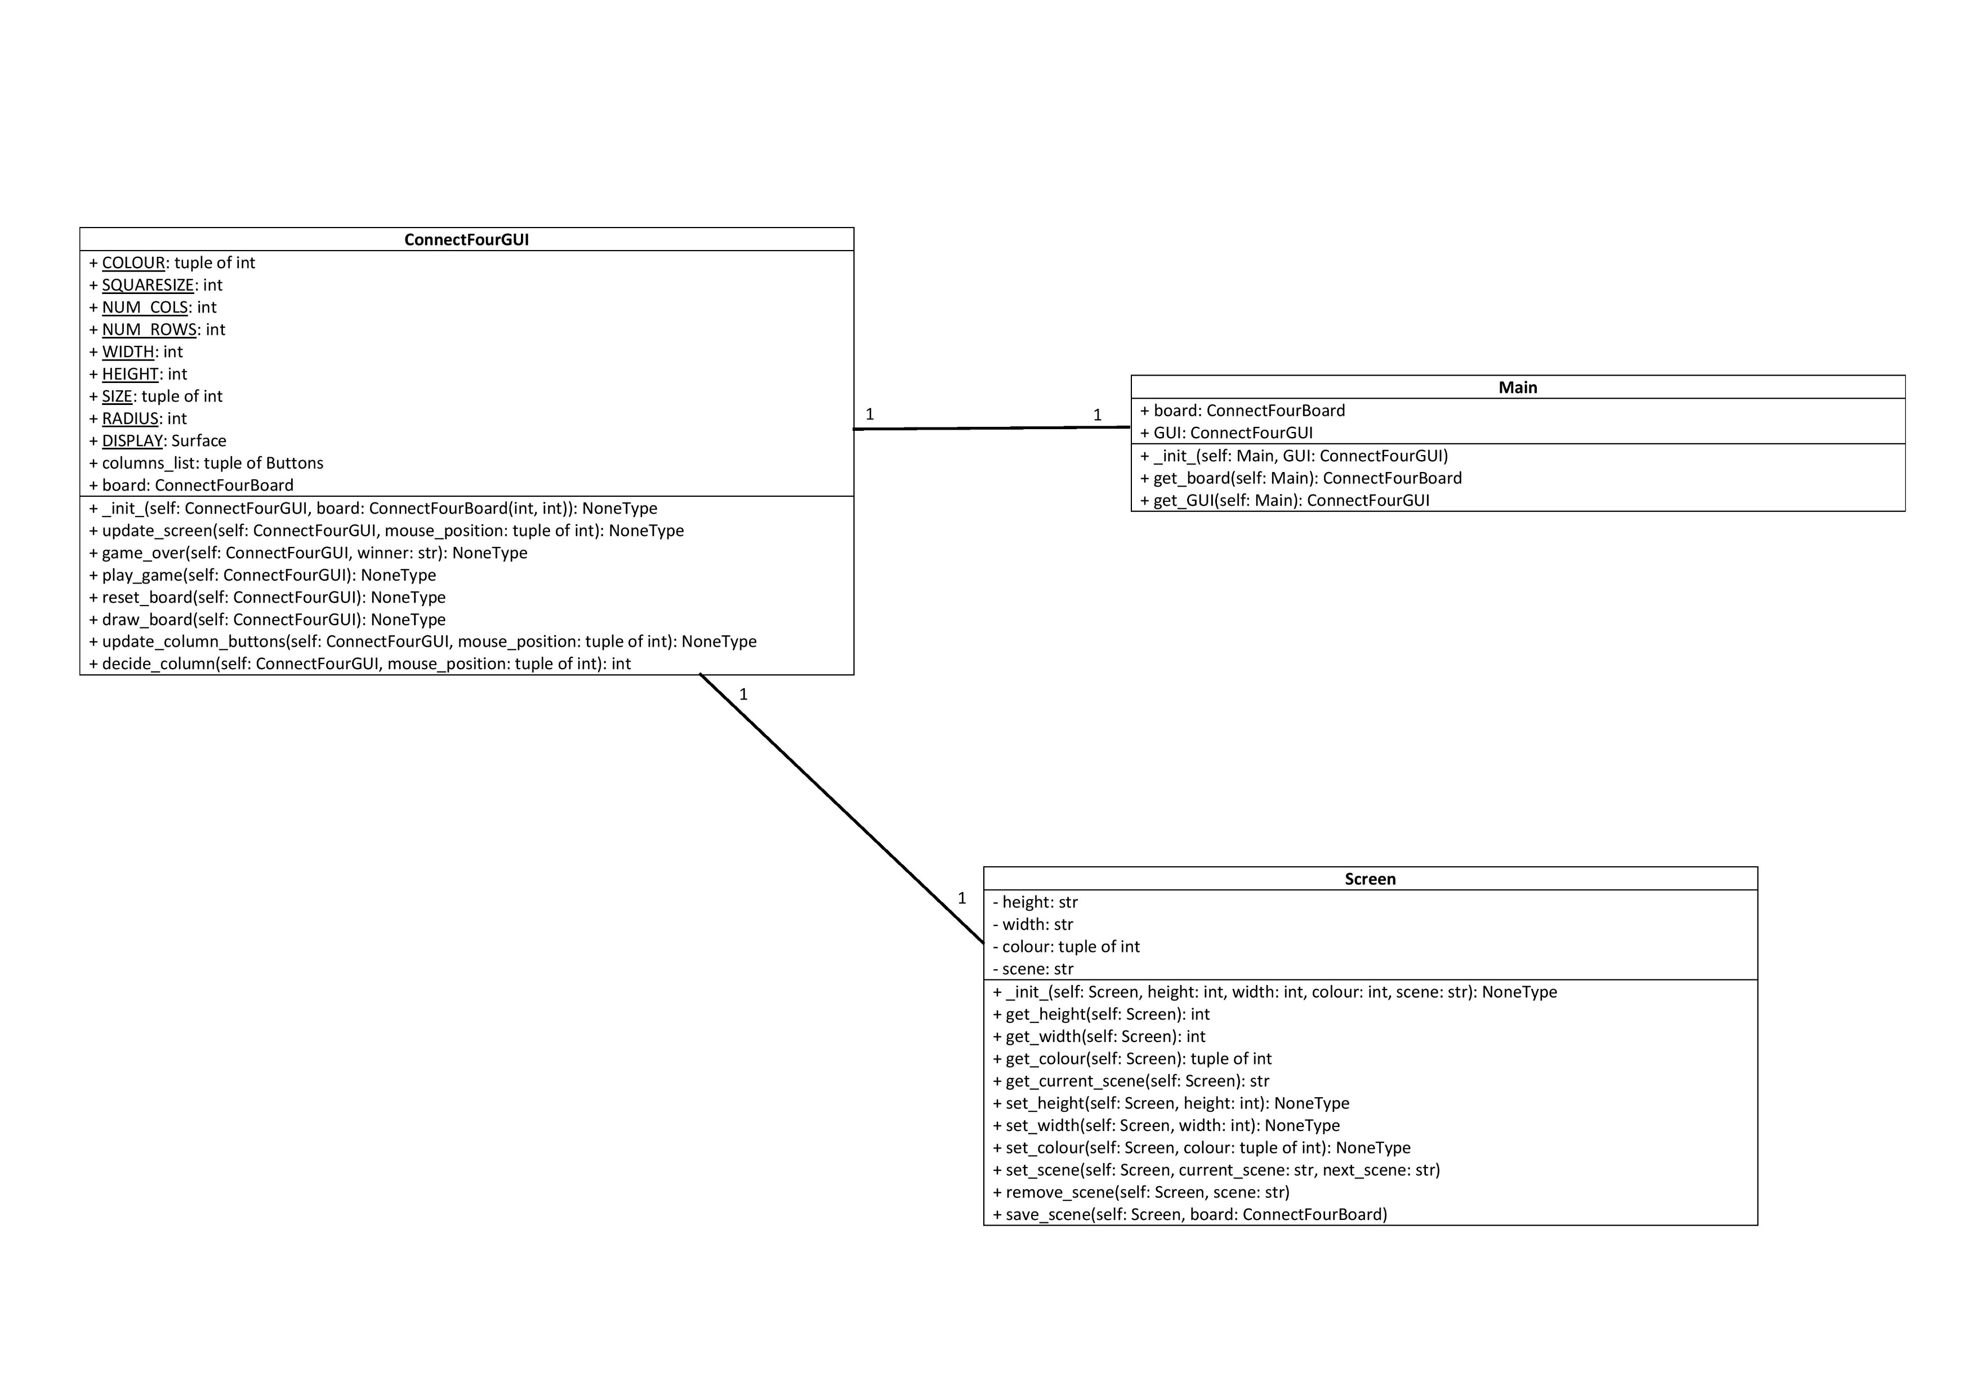
Notes:
10 seconds

Slide 6
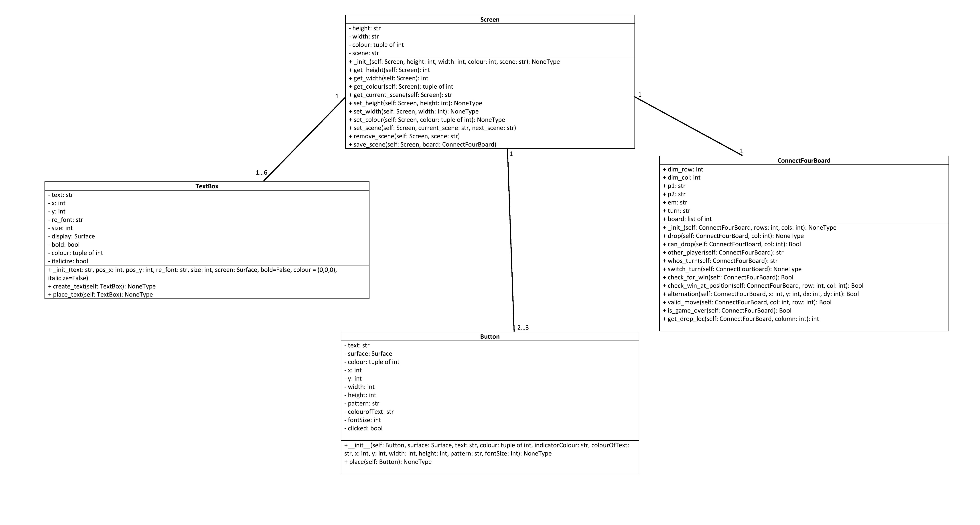
Notes:
20 seconds

Slide 7
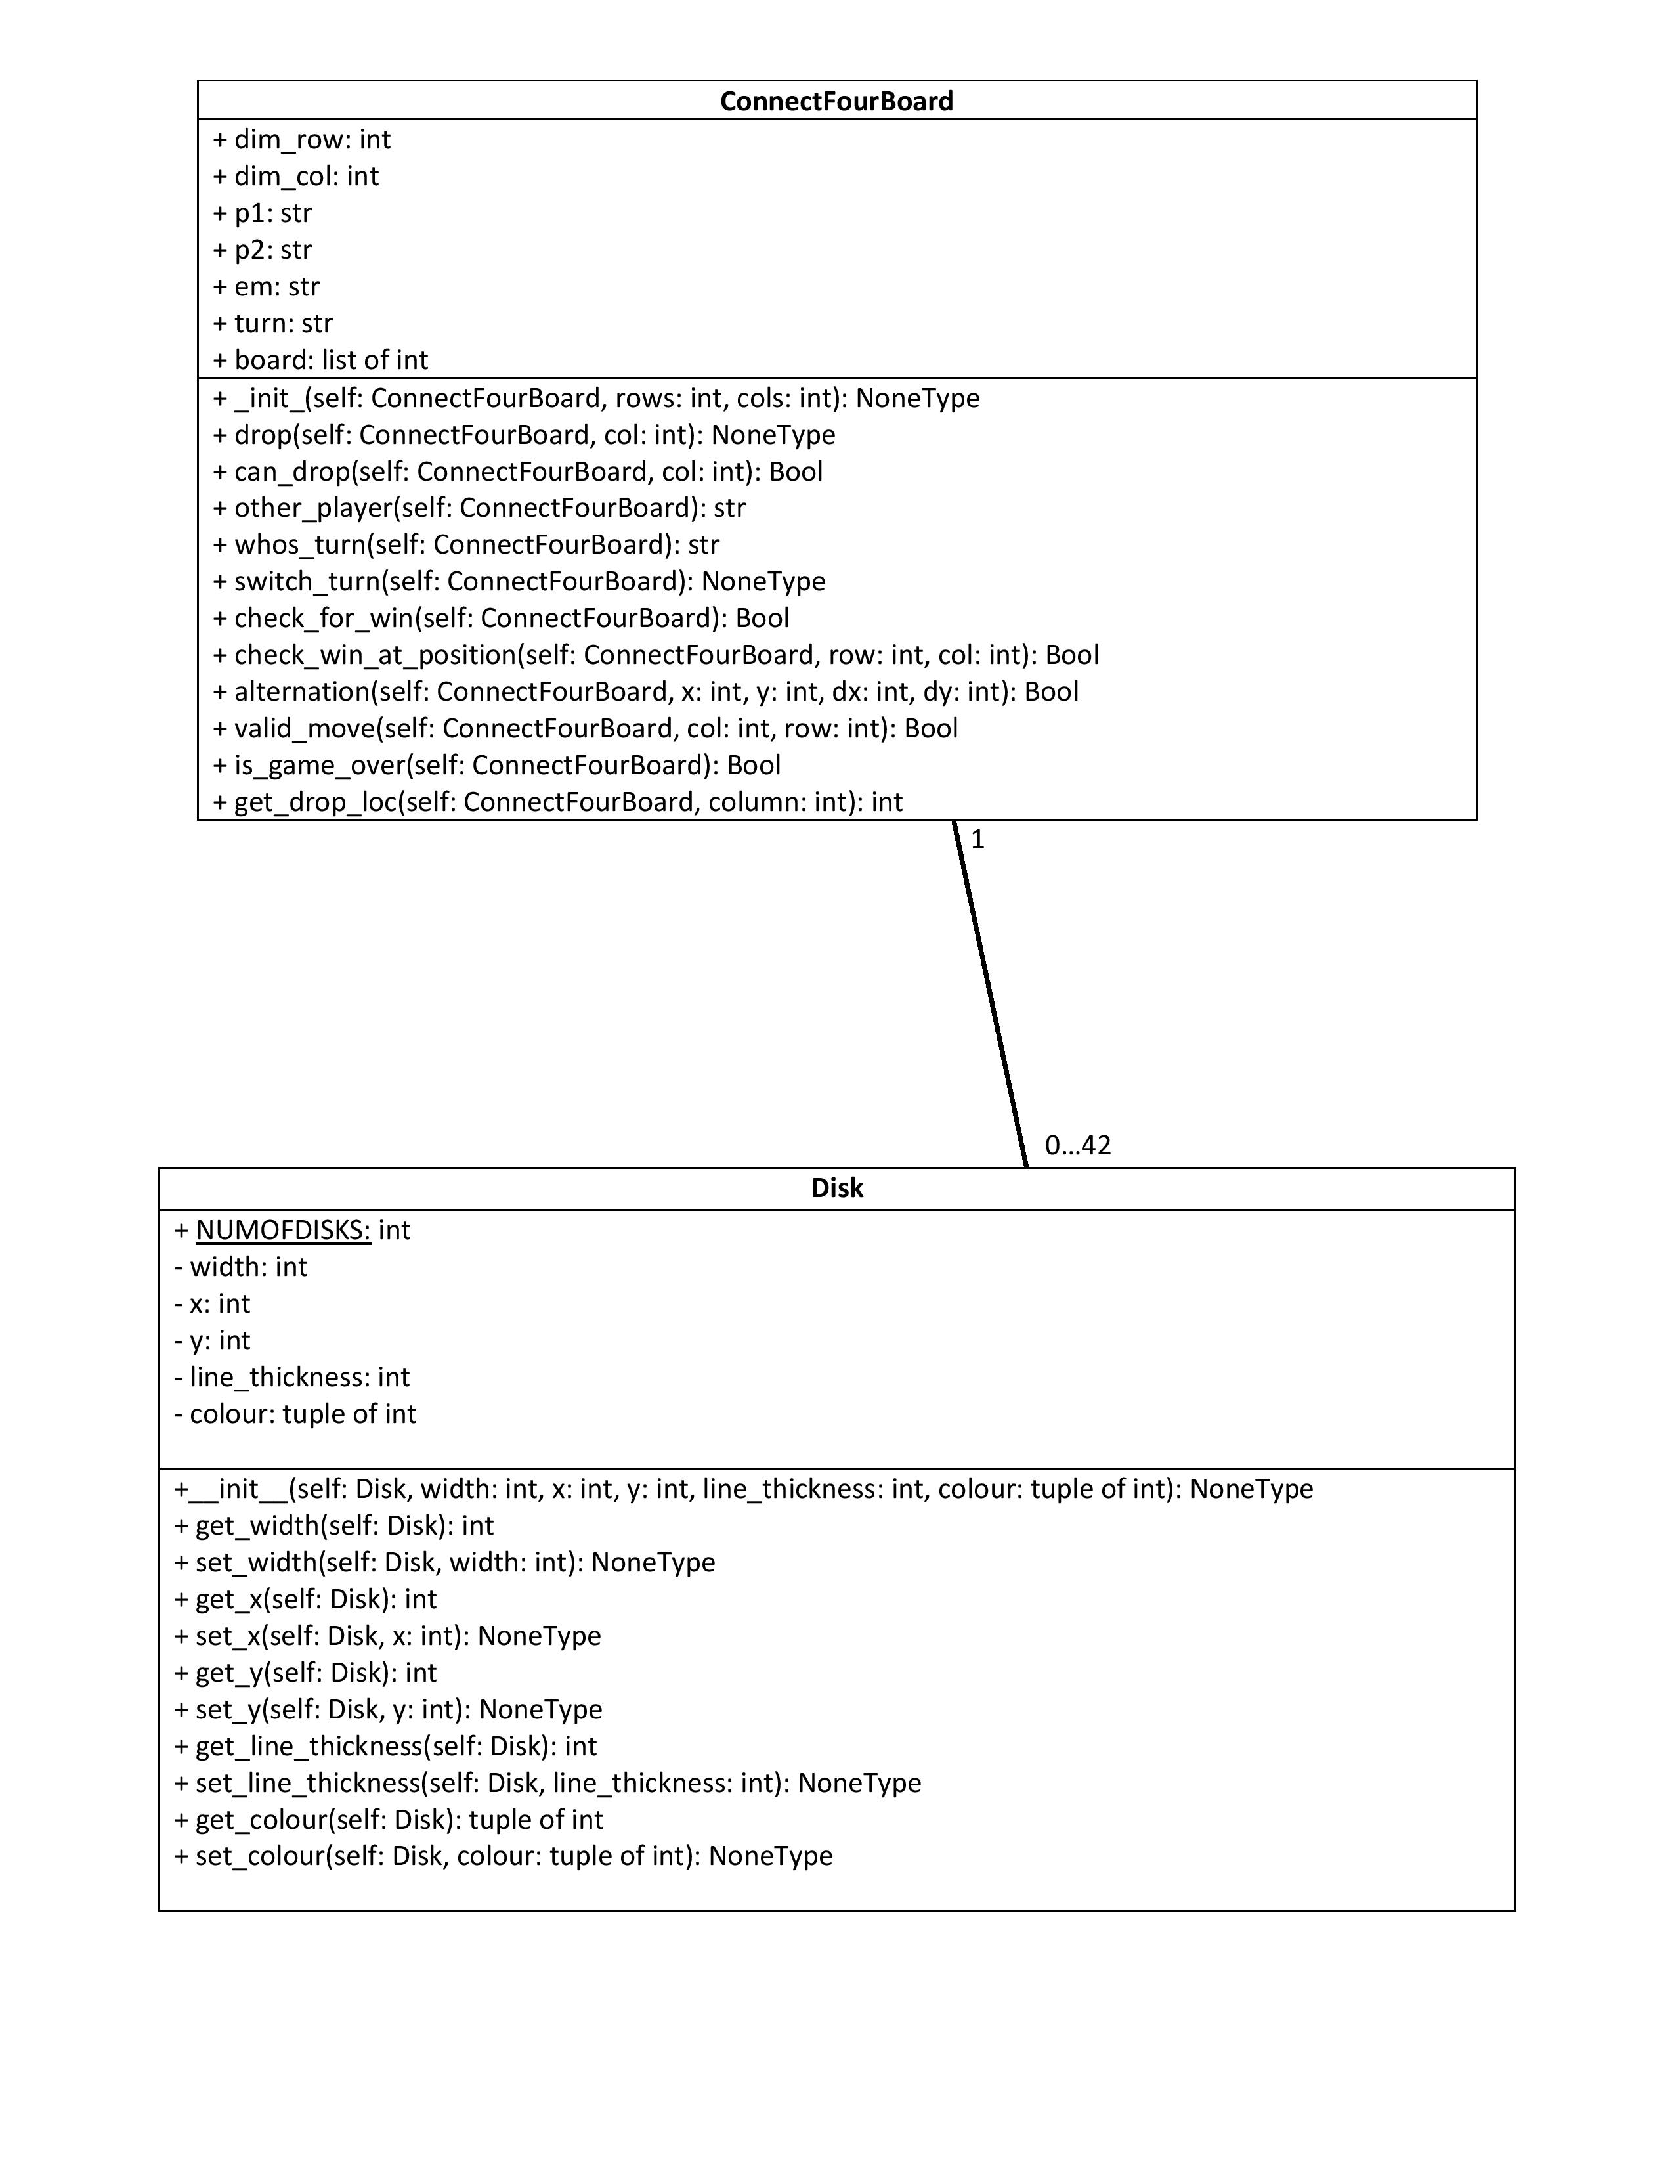
Notes:
10 seconds

